Slide 1
Web Development
Eamonn de Leastar (edeleastar@wit.ie)

Slide 2
CSS: The Box Model
Web Development

Slide 3
Agenda
Box Model
Box Model: Content, Padding, Border & Margin
Background images
Border Styles, Width, Colour
Layout
The DOM, HTML Parsing & Rendering
Box Model Revisited
Formatting Concepts in CSS
Multicolumn layout worked example

Slide 4
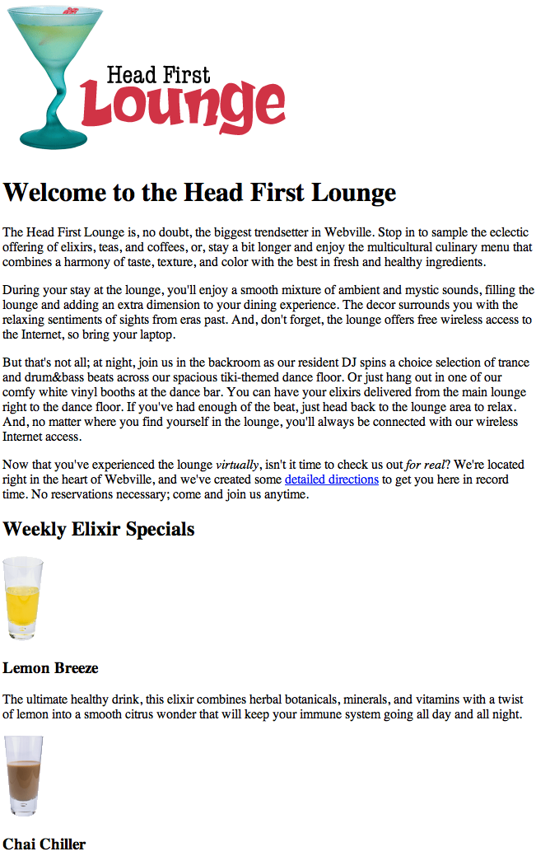
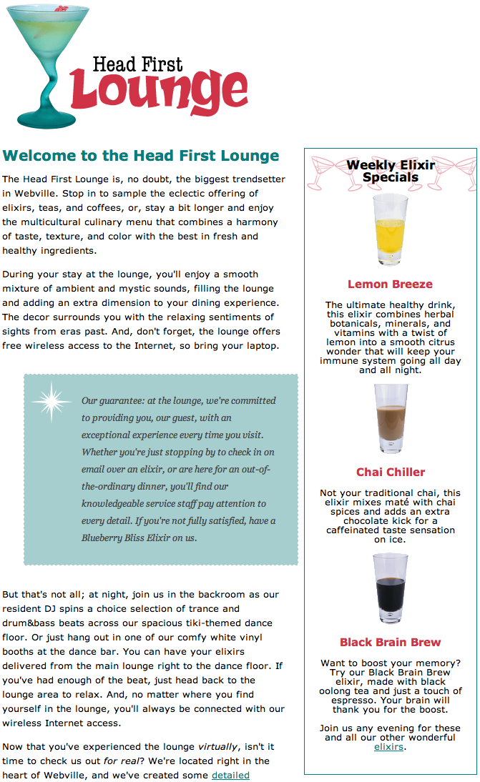

Slide 5
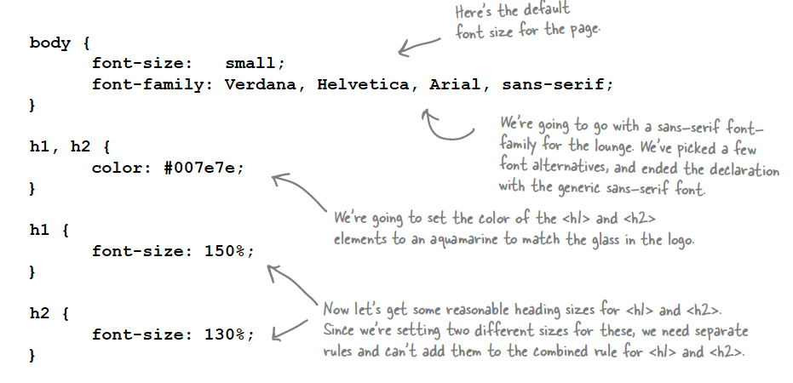

Slide 6


Slide 7
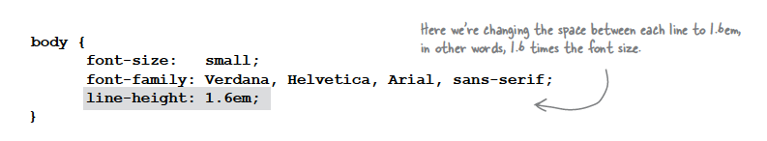
line-height
Increasing the line height of your text can improve readability. It also gives you another way to provide contrast between different parts of your page.
Fonts can be measured in absolute for relative terms:
Absolute:
px - Pixels, absolute, screen oriented
pt - Points, absolute, print oriented
Relative
em - “width of an ‘m’”, 1 = current font width
% - 100% = current font size

Slide 8
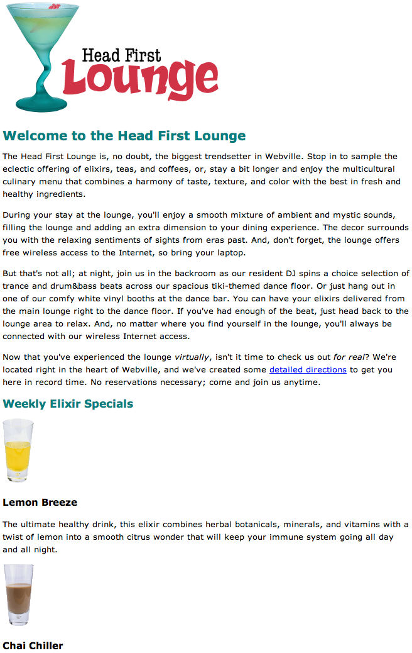

Slide 9
CSS Box Model
Boxes consist of:
Content
Padding
Border
Margin
So far, your CSS has focussed on changing simple properties of elements, like size, color, and decorations. For effective layout control, you have got to move on to the box model.
The box model is how CSS sees elements.
CSS treats every single element as if it were represented by a box.
All elements are treated as boxes: paragraphs, headings, block quotes,lists, list items, and so on. Even inline elements like <em> and links are treated by CSS as boxes

Slide 10
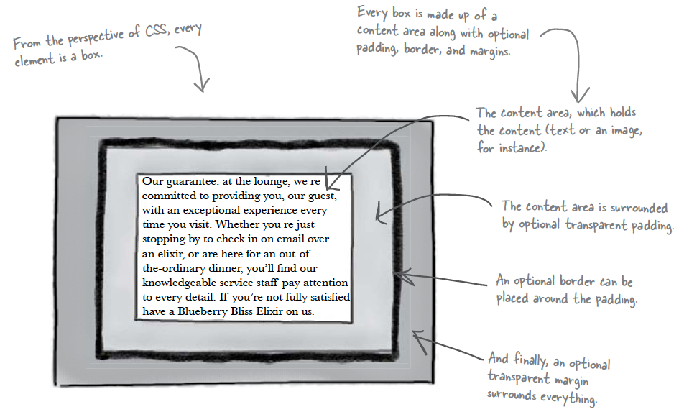

Slide 11
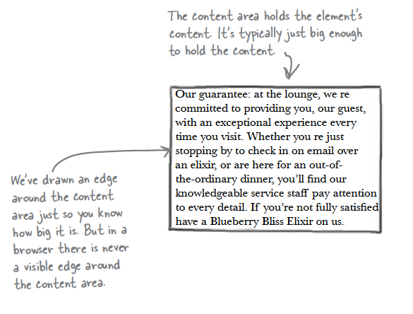
Content Area
Every element starts with some content, like text or an image, and this content is placed inside a box that is just big enough to contain it.
The content area has no whitespace between the content and the edge of the box

Slide 12
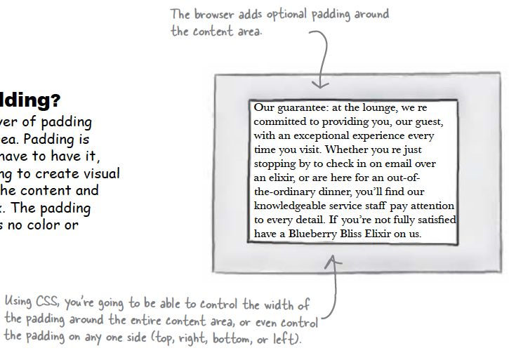
Padding
Any box can have a layer of padding around the content area.
Padding is optional, so you don’t have to have it, but you can use padding to create visual whitespace between the content and the border of the box.
The padding is transparent and has no color or decoration of its own.

Slide 13
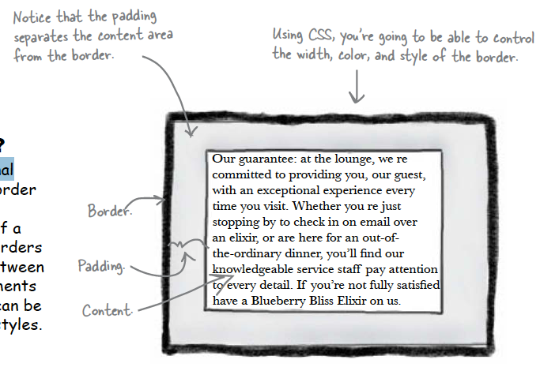
Border
Elements can have an optional border around them
The border surrounds the padding and because it takes the form of a line around the content, borders provide visual separation between content and other elements on the same page
Borders can be various widths, colors and styles

Slide 14
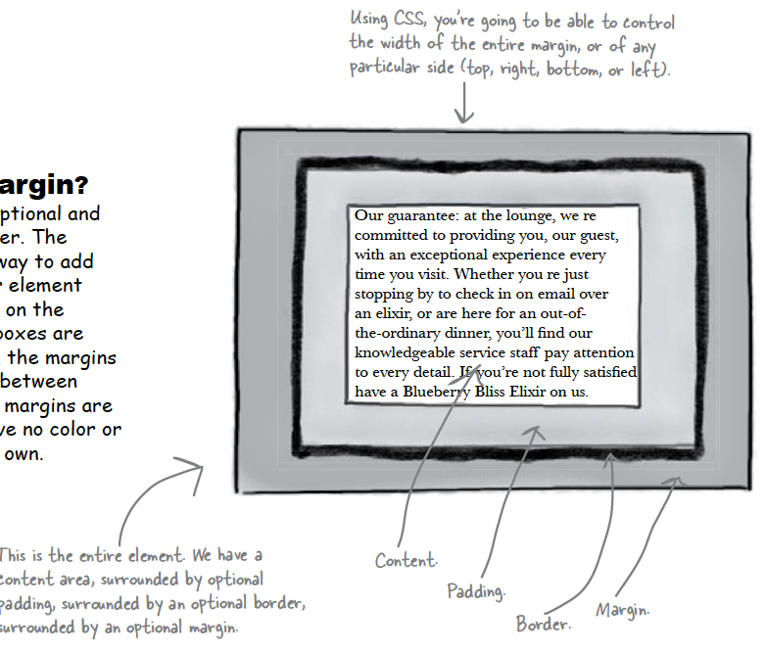
Margin
The margin is also optional and surrounds the border.
The margin gives you a way to add space between your element and other elements on the same page.
If two boxes are next to each other, the margins act as the space in between them.
Like padding, margins are transparent and have no color or decoration of their own.

Slide 15
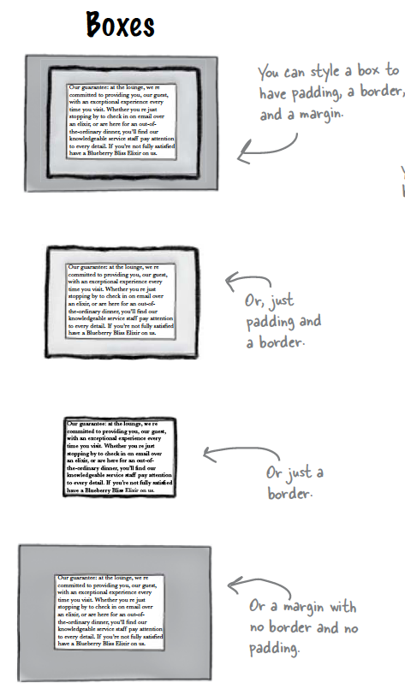
Variations: Boxes
The box model may look simple with just the content, some padding, a border, and margins.
But when you combine these all together there are endless ways you can determine the layout of an element with its internal spacing (padding) and the spacing around it (margins).

Slide 16
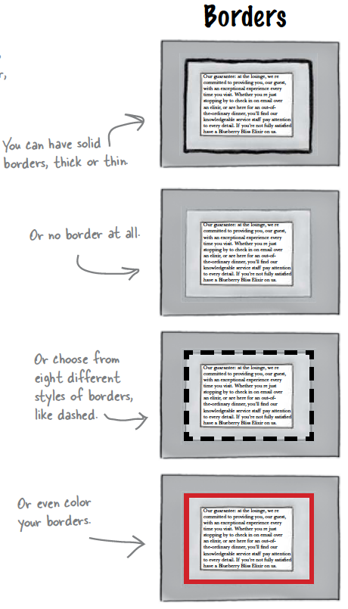
Variations: Borders

Slide 17
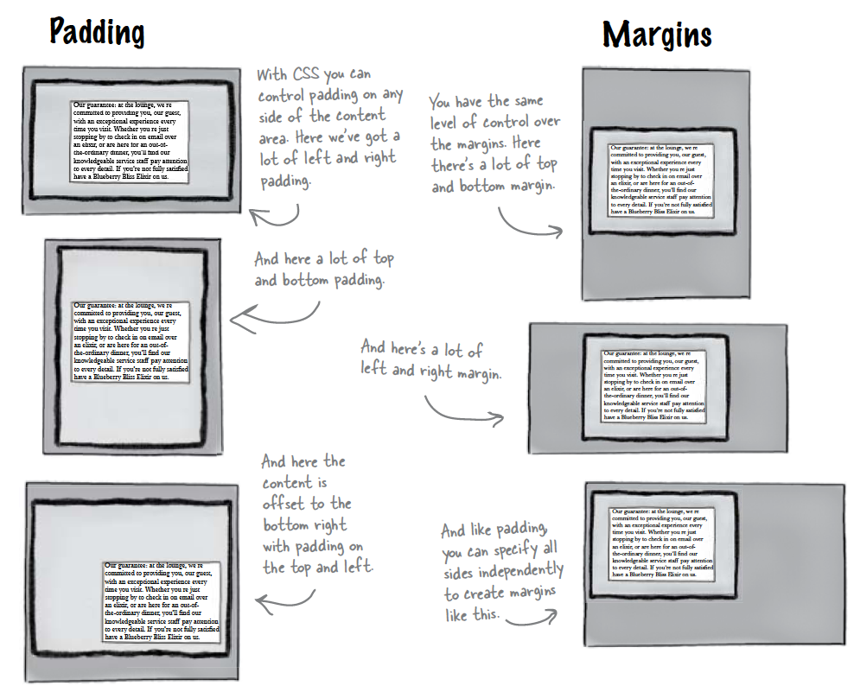
Variations: Padding & Margins

Slide 18
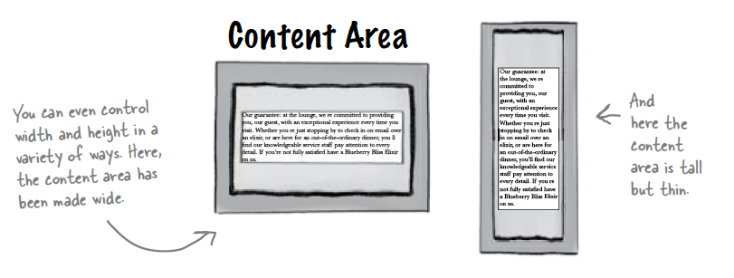
Variations: Content

Slide 19
Box Model in Action

Slide 20
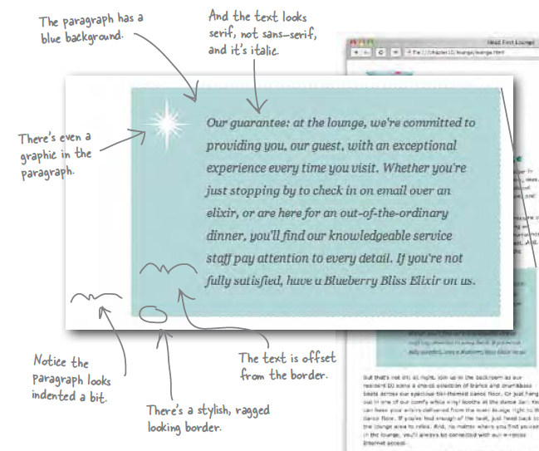
The “Guarantee” box

Slide 21
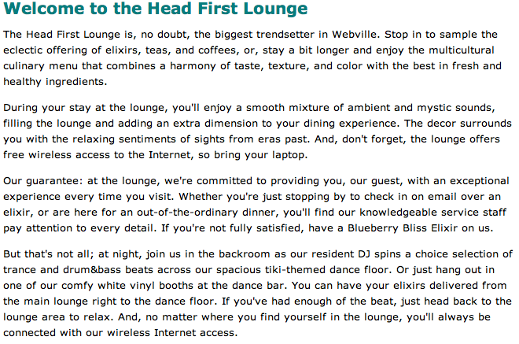
Use class to identify the “guarantee” paragraph
No styling initially
<p class="guarantee">
Our guarantee: at the lounge, we're committed to providing you,
our guest, with an exceptional experience every time you visit.
Whether you're just stopping by to check in on email over an
elixir, or are here for an out-of-the-ordinary dinner, you'll
find our knowledgeable service staff pay attention to every detail.
If you're not fully satisfied, have a Blueberry Bliss Elixir on us.
</p>

Slide 22
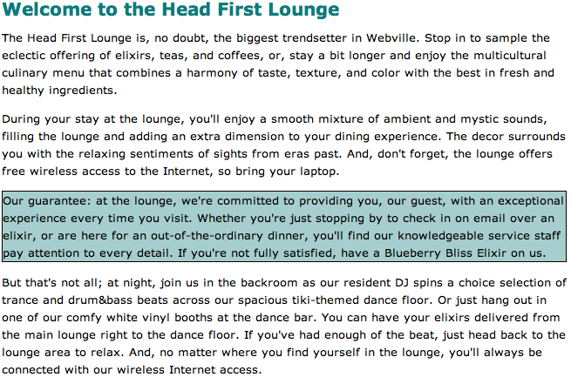
No padding around the content - i.e no space between text and border
No margin left/right
But there seems to be a margin top/bottom? -> Check Default Style Sheet
.guarantee
{
border-color: black;
border-width: 1px;
border-style: solid;
background-color: #a7cece;
}

Slide 23
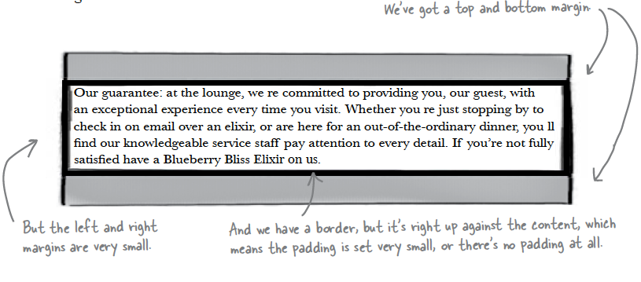
Box Model
Here’s what the paragraph would look like if we drew it as a box model diagram

Slide 24
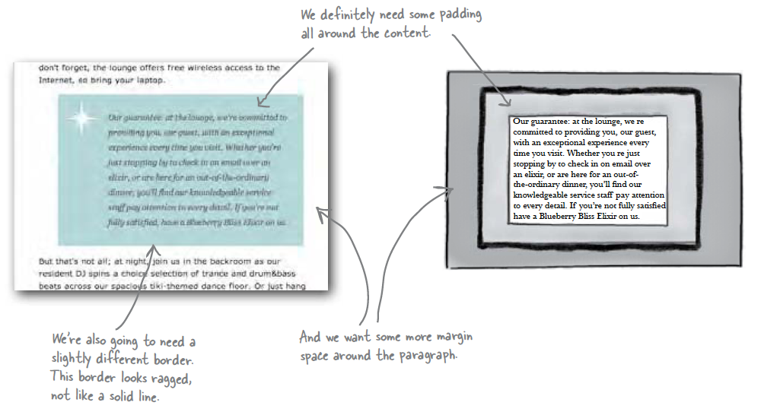
What we want:

Slide 25
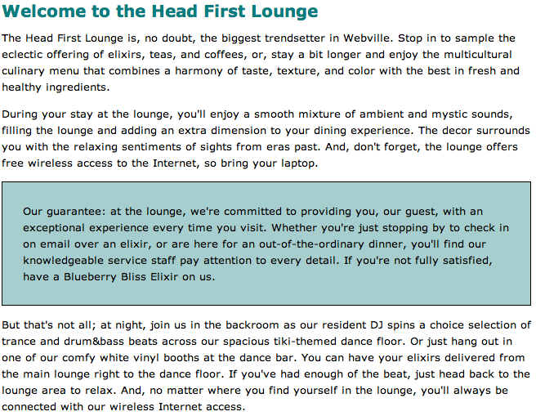
Add Padding
.guarantee
{
border-color: black;
border-width: 1px;
border-style: solid;
background-color: #a7cece;
padding: 25px;
}
Can be either to a number of pixels or a percentage of area inside the border

Slide 26
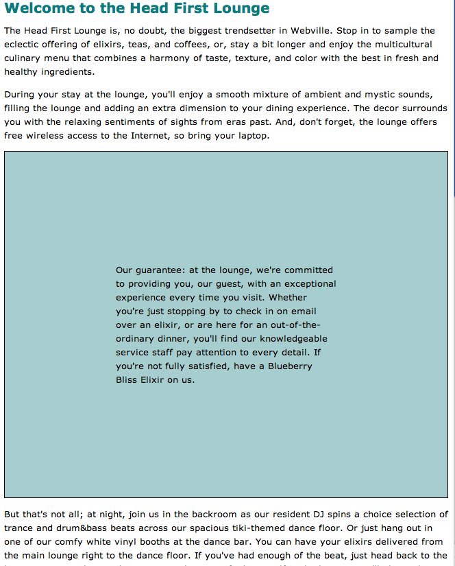
Had we chosen %
.guarantee
{
border-color: black;
border-width: 1px;
border-style: solid;
background-color: #a7cece;
padding: 25%;
}

Slide 27
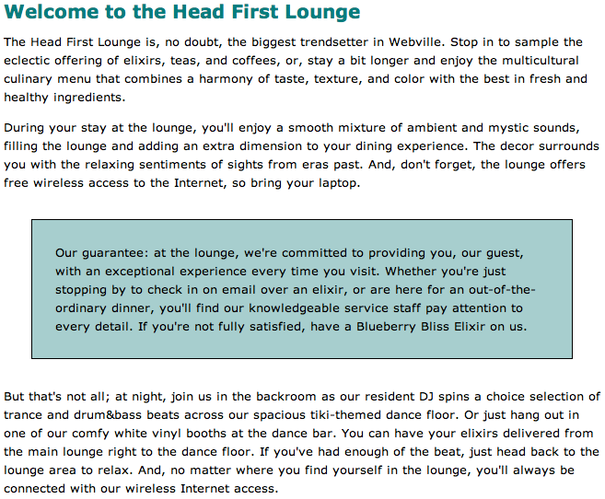
Add Margin
Now we have 25 pixels of margin on all sides.
.guarantee
{
border-color: black;
border-width: 1px;
border-style: solid;
background-color: #a7cece;
padding: 25px;
margin: 30px;
}

Slide 28
Agenda
Box Model
Content, Padding, Border & Margin
Background images
Border Styles, Width, Colour

Slide 29

Add a Background Image
Background.gif
<img> and background images:
An <img> element, on the other hand, is used to include an image that has a more substantial role in the page, like a photo or a logo
A background image is pure presentation, and the only reason you would use a background-image is to improve the attractiveness of an element.
We could have just placed the image inside the paragraph, and we could probably get the same look and feel, but the guarantee star is pure decoration
It has no real meaning on the page and it’s only meant to make the element look better. So, background-image makes more sense.

Slide 30
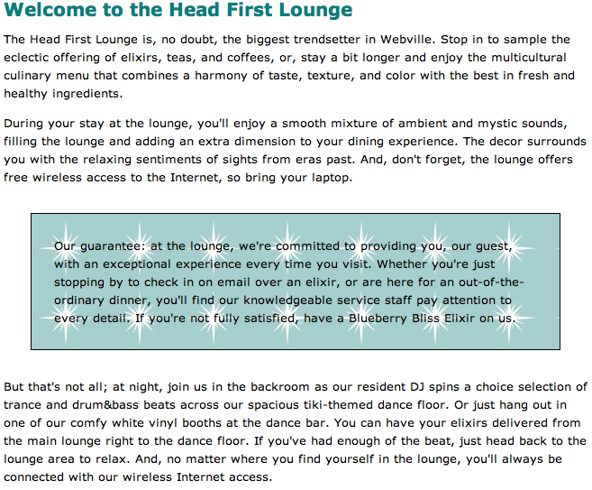
Background Image
.guarantee
{
border-color: black;
border-width: 1px;
border-style: solid;
background-color: #a7cece;
padding: 25px;
margin: 30px;
background-image: url(images/background.gif);
}
Image sits on top of the background color.
Because it has a transparent background, it lets the color show through
The background images, like the background color, only show under the content area and padding, and not outside the border in the margin

Slide 31
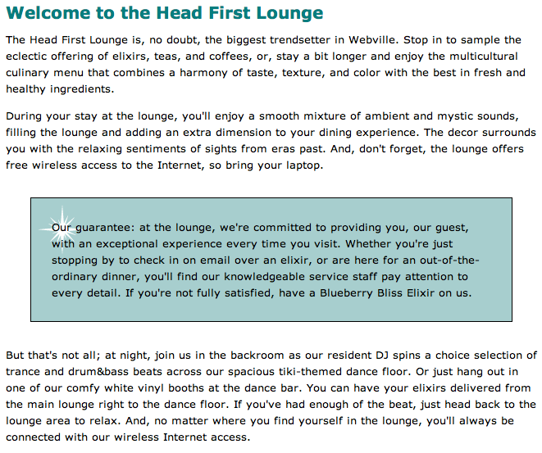
By default, background images are repeated.
The no-repeat value for the background-repeat property turns this off, so we get just one image.
By default, browsers position a background image in the top, left of the element
.guarantee
{
border-color: black;
border-width: 1px;
border-style: solid;
background-color: #a7cece;
padding: 25px;
margin: 30px;
background-image: url(images/background.gif);
background-repeat: no-repeat;
background-position: top left
}

Slide 32
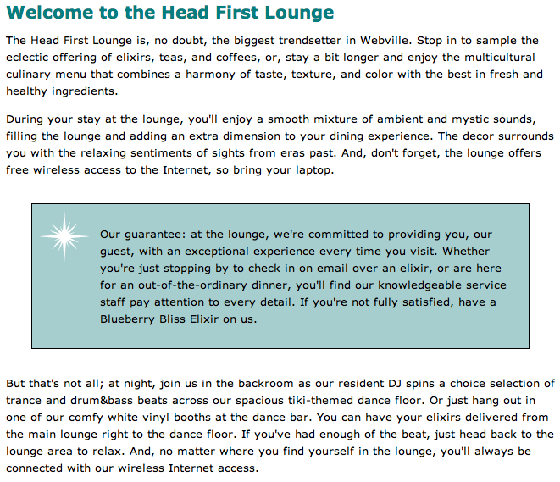
More Padding
For padding, margins, and even borders, CSS has a property for every direction: top, right, bottom, and left.
To add padding on the left side, use the padding-left property
.guarantee
{
border-color: black;
border-width: 1px;
border-style: solid;
background-color: #a7cece;
padding: 25px;
padding-left: 80px;
margin: 30px;
background-image: url(images/background.gif);
background-repeat: no-repeat;
background-position: top left
}

Slide 33
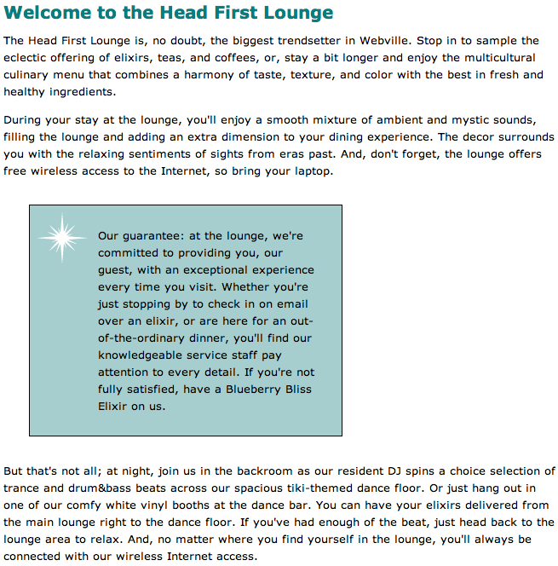
More Margins
.guarantee
{
border-color: black;
border-width: 1px;
border-style: solid;
background-color: #a7cece;
padding: 25px;
padding-left: 80px;
margin: 30px;
margin-right: 250px;
background-image: url(images/background.gif);
background-repeat: no-repeat;
background-position: top left
}

Slide 34
Using DIVs to define sections
Main content
Releases
36
While we have used the box model to specify space within (i.e., padding) and outside (i.e., margin) the border of an element, it can also be employed to specify the position of portions of text on the page
We could, for example, add content related to new releases on the right hand-side and the main content on the left-hand side as illustrated in the next diagram, using a two-column layout

Slide 35
Using Divs to define
To achieve this we could do the following:
Use DIV elements as containers, one for the main content and one for the left content
Allocate an ID to each of these divs
Create CSS rules for each DIVs so that they are floating to the left and right of the page, respectively
#releases
{
…
float:right;
}
#maincontent
{
…
float:left;
}
<DIV id = maincontent>
…
</DIV>
<DIV id = releases>
…
</DIV>
37

Slide 36
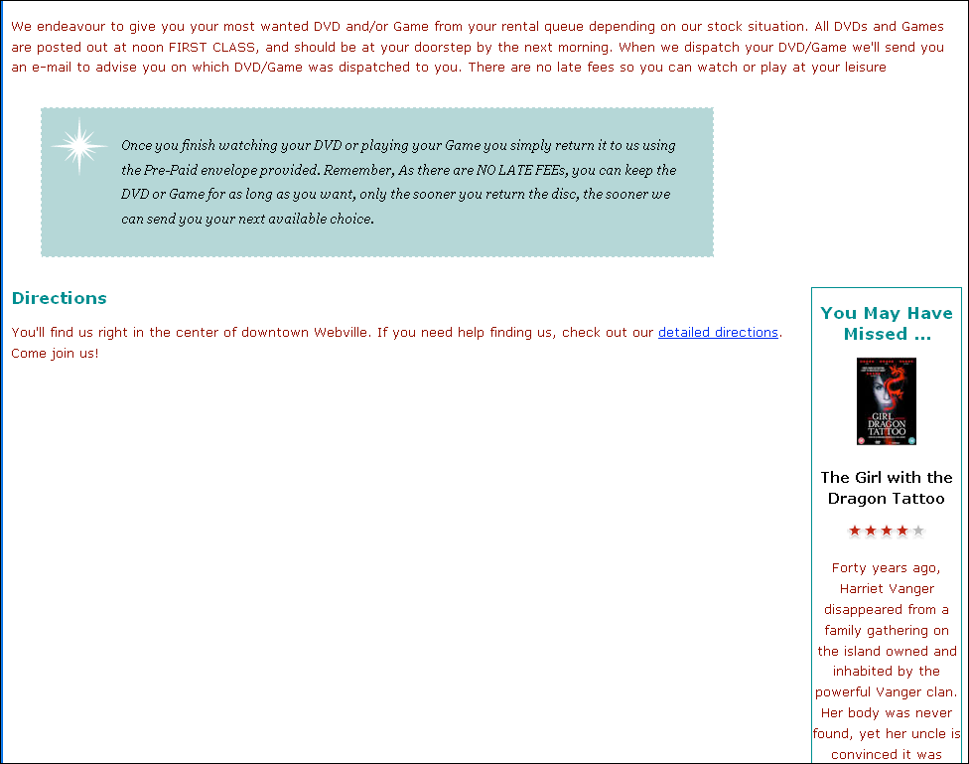
#releases
{
border-width: thin;
border-style: solid;
border-color: #007e7e;
width: 150px;
padding: 0px 20px 30px 10px
margin-left: 20px;
text-align: center;
float:right;
}

Slide 37
#releases
{
border-width: thin;
border-style: solid;
border-color: #007e7e;
width: 150px;
padding: 0px 20px 30px 10px
margin-left: 20px;
text-align: center;
float:right;
}
#maincontent
{
float:left;
width:800px;
}
#maincontent
{
float:left;
width:800px;
}

Slide 38
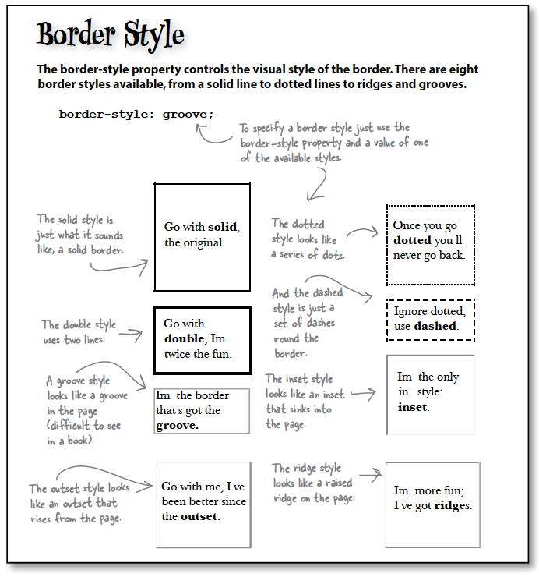

Slide 39
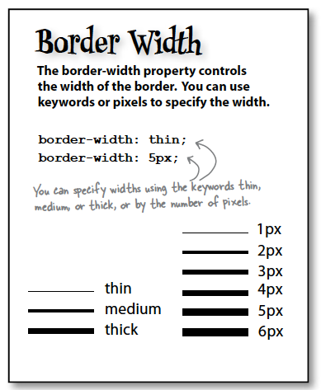
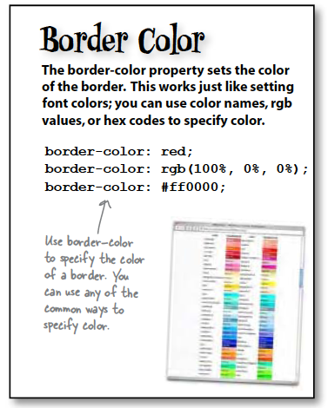

Slide 40
